Slide 1

AI-Driven Predictive Maintenance System for Industrial Equipment
(An AIML Domain Project)
Submitted by,
Vedant Bhaskar Porje (PRN: 72312326J)
Under the Guidance of
Prof. Mrs. Mayuri A. Khade
PES Modern College of Engineering
Department of Computer Engineering
Savitribai Phule Pune University
25-February-2026
Dept of Computer Engineering

Slide 2
Outline
Internship Completion Certificate
Introduction
Problem Statement
Objectives
Scope
Project Limitations
Dataset Description
Technological Details
Architecture Diagram
Feature Engineering Strategy
Model Performance & Evaluation
Anamoly Detection & Early Warning Analysis
Result
Conclusion
Future Scope\
Research and References
Dept of Computer Engineering

Slide 3
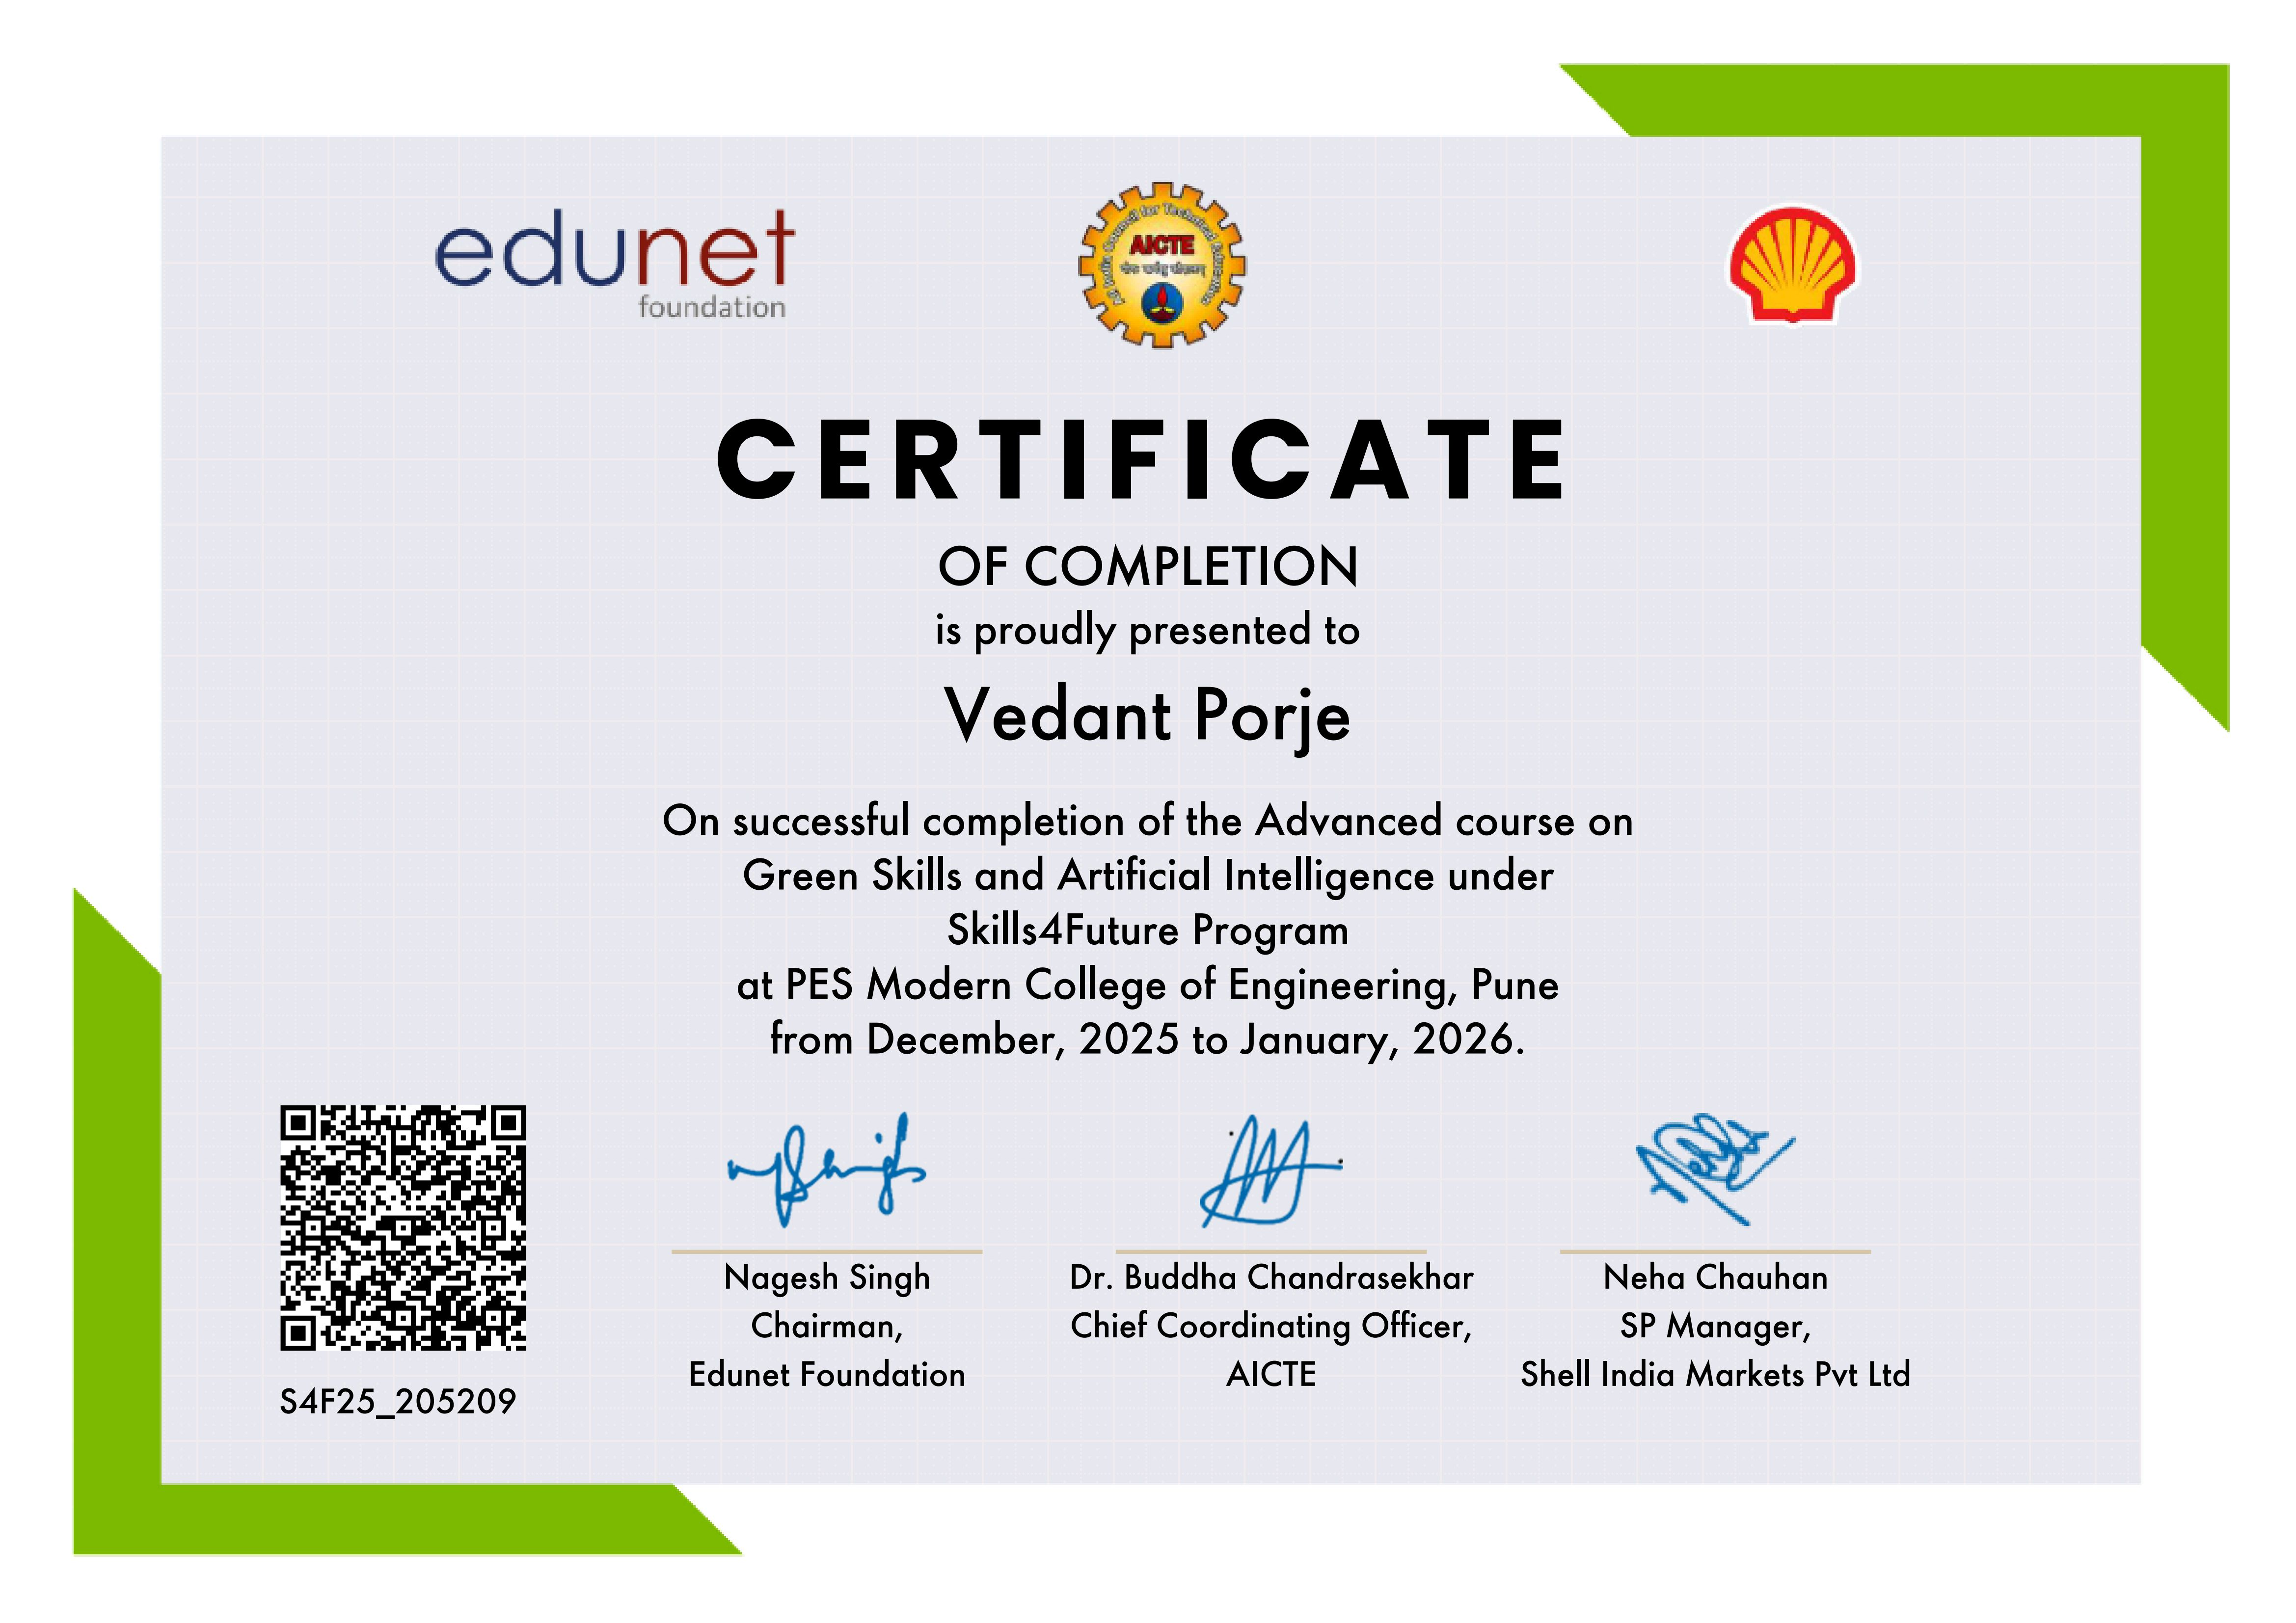
Internship Completion Certificate
Dept of Computer Engineering

Slide 4
Introduction
Unplanned equipment failures cause significant financial losses in industrial environments, and traditional maintenance strategies — whether reactive or scheduled — remain inefficient and costly. The growing availability of industrial sensor data offers a better path forward, enabling real-time monitoring of equipment health. By leveraging machine learning to identify degradation patterns, this project develops an end-to-end AI system that predicts Remaining Useful Life (RUL) and detects anomalies early, integrated with an interactive dashboard for real-time visibility and informed maintenance decisions.
Dept of Computer Engineering

Slide 5
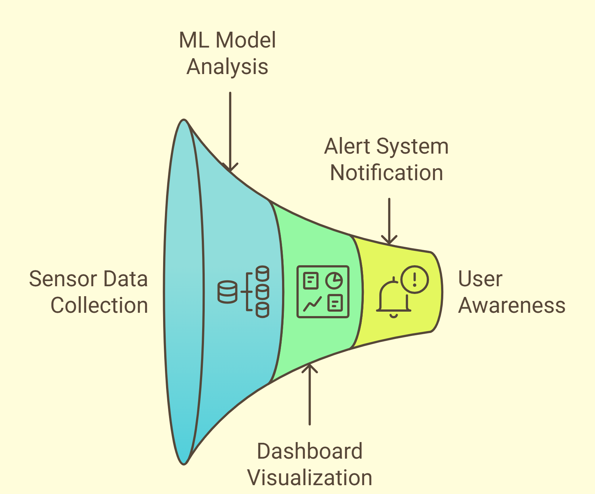
Introduction
Dept of Computer Engineering

Slide 6
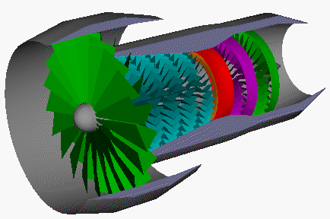
Problem Statement
Industries rely heavily on rotating machinery and engine systems.
Unexpected failures lead to:
Production downtime
High maintenance cost
Safety risks
Operational inefficiency
There is a need to develop a system that:
Detects abnormal operational behavior early
Provides actionable alerts before failure
Enables data-driven maintenance decisions
Predicts Remaining Useful Life (RUL) of equipment
Dept of Computer Engineering

Slide 7
Objectives
Functional Objectives
Predict Remaining Useful Life (RUL) using machine learning.
Detect abnormal behavior using anomaly detection.
Provide early warning signals before system failure.
Visualize degradation trends through an interactive dashboard.
Technical Objectives
Implement Random Forest for RUL prediction.
Implement Isolation Forest for anomaly detection.
Perform feature engineering (rolling statistics on sensor data).
Build a deployable monitoring dashboard using Streamlit.
Non-Functional Objectives
Ensure scalable and modular design.
Maintain real-time responsiveness.
Provide clear and interpretable visual insights.
Deliver a user-friendly monitoring interface.
Dept of Computer Engineering

Slide 8
Scope
Applicable to industrial rotating machinery and engine systems.
Designed for predictive maintenance in manufacturing, aviation, and heavy industry.
Supports data-driven maintenance planning instead of reactive repair.
Can be extended to real-time IoT sensor streams.
Scalable for multiple engines and large sensor datasets.
Adaptable to different types of equipment with retraining.
Can be integrated with enterprise monitoring systems.
Dept of Computer Engineering

Slide 9
Project Limitations
Currently validated on simulated NASA turbofan dataset.
Performance depends on quality and consistency of sensor data.
Requires retraining for different machine types.
Dept of Computer Engineering

Slide 10
Dataset Description
Dataset Used
NASA CMAPSS Turbofan Engine Degradation Simulation Dataset
Source: NASA Prognostics Data Repository
Dataset: FD001 subset
Type: Multivariate time-series sensor data
Total Engines: 100 (training)
Sensors per engine: 21 sensors
Operational settings: 3
Why This Dataset?
Industry-standard benchmark for predictive maintenance research.
Simulates realistic degradation patterns.
Widely used in academic and industrial studies.
Dept of Computer Engineering

Slide 11
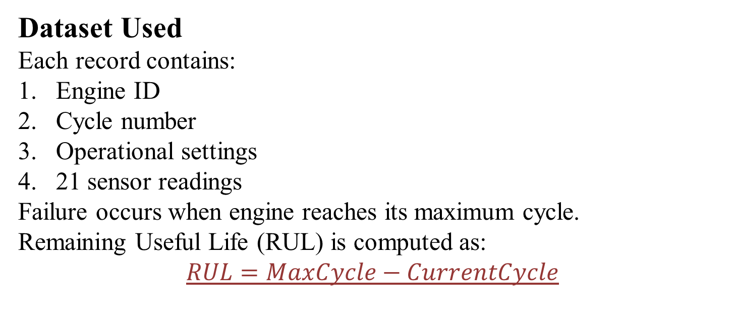
Dataset Description
Dataset Used
Each record contains:
Engine ID
Cycle number
Operational settings
21 sensor readings
Failure occurs when engine reaches its maximum cycle.
Remaining Useful Life (RUL) is computed as:
$$RUL=MaxCycle−CurrentCycle$$
Dept of Computer Engineering

Slide 12
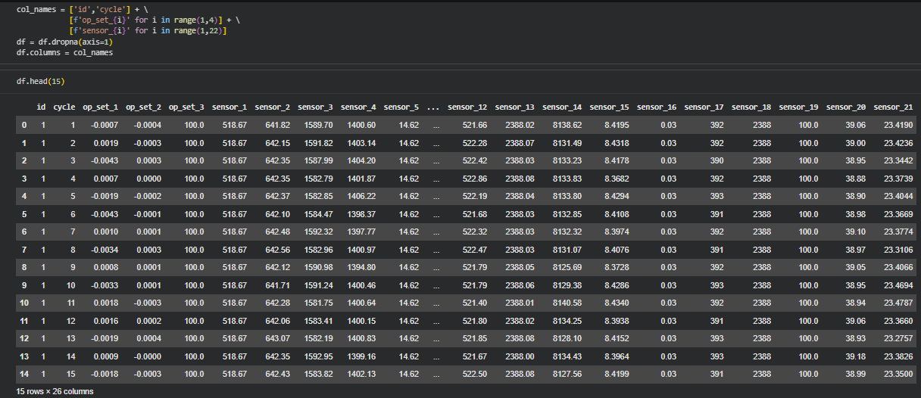
Dataset Description
Dept of Computer Engineering

Slide 13
Technological Details
Programming Environment
Python
Pandas, NumPy, Matplotlib, Plotly
Scikit-learn, Streamlit, Joblib
Machine Learning Models
Random Forest Regressor – RUL prediction, handles nonlinear degradation and noise
Isolation Forest – Anomaly detection, trained on healthy cycles to flag deviations
Deployment
Streamlit dashboard with multi-engine visualization and real-time anomaly threshold tuning
Dept of Computer Engineering

Slide 14
Methodology
Step 1: Data Preprocessing
Assigned column names, removed low-variance sensors
Calculated and capped RUL for regression stability
Step 2: Feature Engineering
Correlation-based sensor selection
Rolling mean & std dev (window = 5), grouped engine-wise to prevent leakage
Step 3: Model Training
Engine-level train-test split
Linear Regression (baseline) → Random Forest (primary)
Evaluated using RMSE & MAE
Step 4: Anomaly Detection
Defined healthy region (RUL > 100)
Trained Isolation Forest → generated anomaly scores & early warnings
Step 5: Deployment
Serialized models via Joblib
Streamlit dashboard visualizing RUL, anomaly scores, lead time & risk indicator
Dept of Computer Engineering

Slide 15
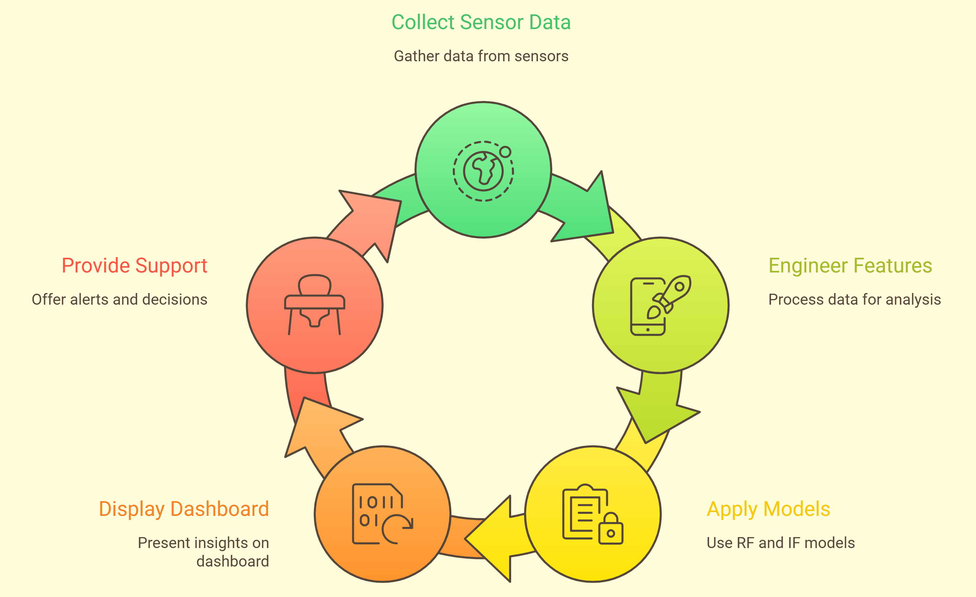
System Architecture
Dual-model framework combining supervised RUL prediction and unsupervised anomaly detection for robust failure forecasting.
Dept of Computer Engineering

Slide 16
Feature Engineering Strategy
Objective: To extract degradation patterns from raw sensor signals.
Removed low-variance sensors
Selected high-correlation degrading sensors
Applied Rolling Mean (window = 5)
Applied Rolling Standard Deviation
Grouped operations engine-wise (prevent leakage)
Applied RUL Capping for regression stability
Dept of Computer Engineering

Slide 17
Model Performance and Evaluation
Key Metrices
Model | RMSE | MAE
Linear Regression | 21.17 | 17.03
Random Forest | 17.90 | 12.85
Random Forest significantly outperformed Linear Regression
Nonlinear degradation captured effectively
Random Forest reduced prediction error by ~15%, indicating nonlinear degradation behavior in engine sensors.
Dept of Computer Engineering

Slide 18
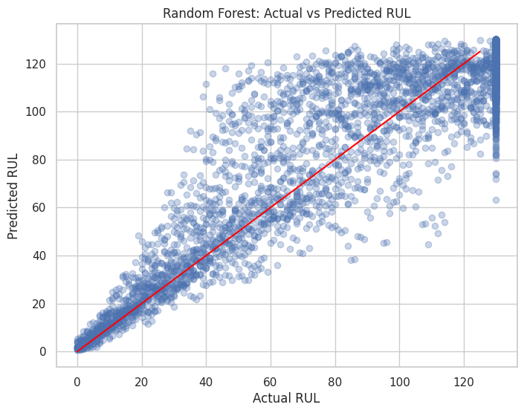
Model Performance and Evaluation
Scatterplot:
Actual RUL vs Predicted RUL
(Random Forest)
What it shows:
Points clustered around diagonal
Improved alignment compared to baseline
Reduced spread at lower RUL
Label clearly:
X-axis: Actual RUL
Y-axis: Predicted RUL
Dept of Computer Engineering

Slide 19
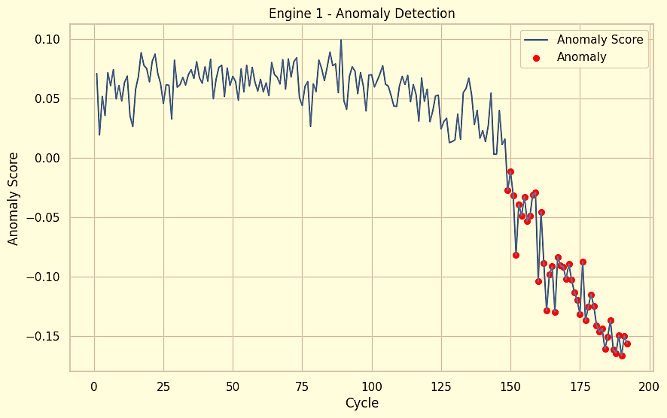
Anomaly Detection & Early Warning Analysis
Healthy Training Logic
Isolation Forest trained only on healthy cycles
Healthy defined as: RUL > 100
Model learns normal operational distribution
Anomaly Monitoring
Generated anomaly score per cycle
Lower score → higher abnormality
Threshold-based risk classification
Early Warning Insight
First anomaly detected ~40 cycles before failure
Enables proactive maintenance planning
Provides redundancy alongside RUL prediction
Dept of Computer Engineering

Slide 20
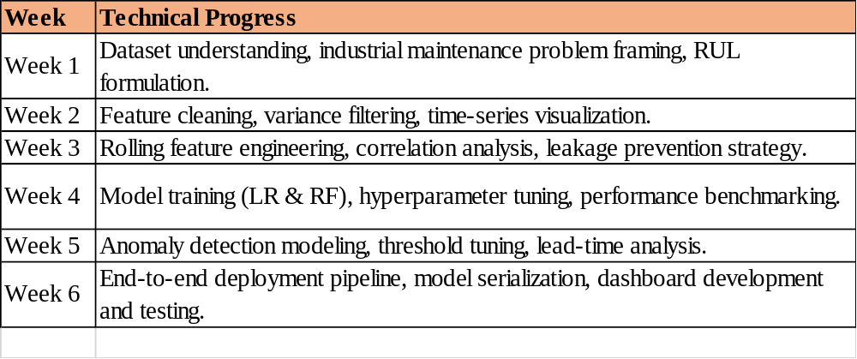
Weekly Work Details
Milestones Achieved:
Achieved RF RMSE ≈ 17.9
Successfully detected anomalies ~40 cycles before failure
Deployed interactive monitoring system
Dept of Computer Engineering

Slide 21
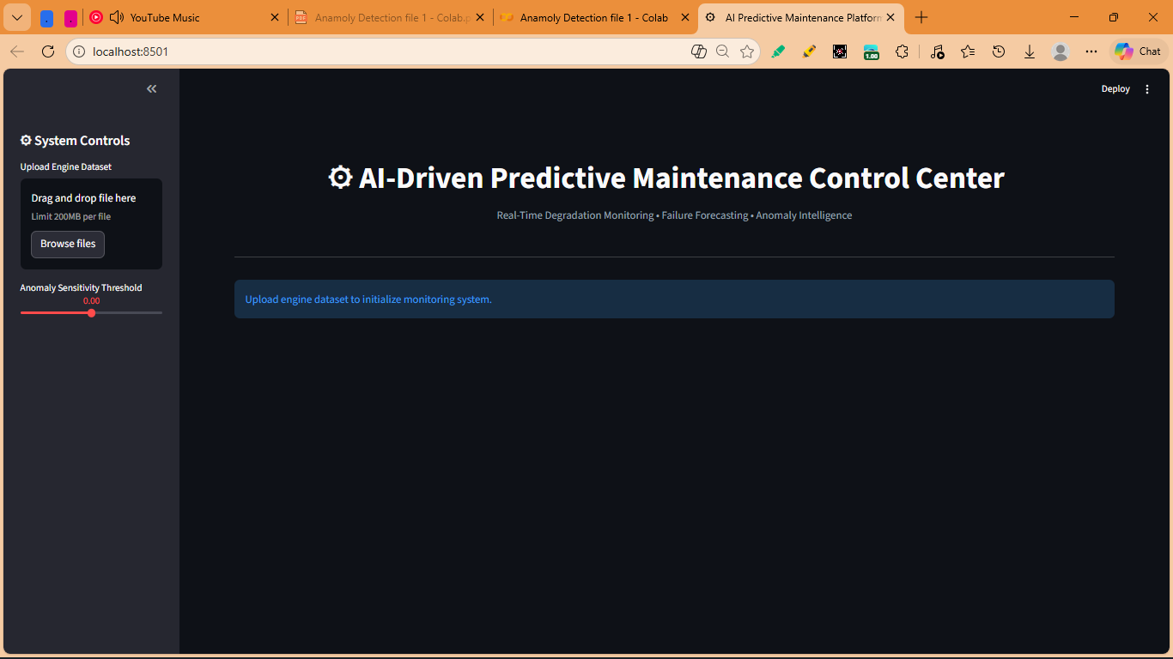
Results
Dept of Computer Engineering

Slide 22
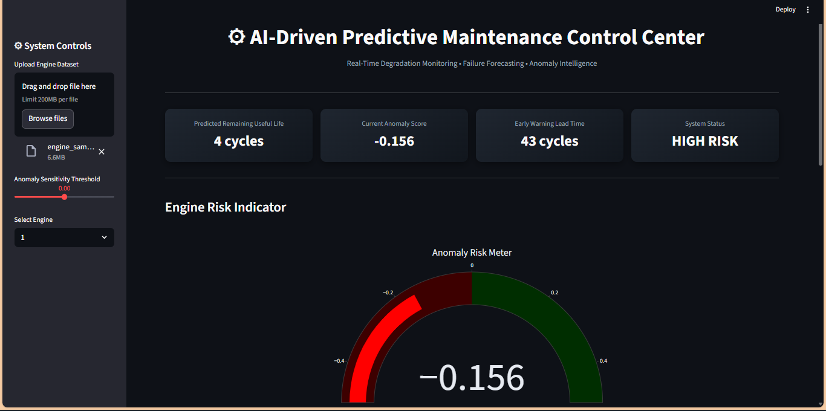
Results
Dept of Computer Engineering

Slide 23
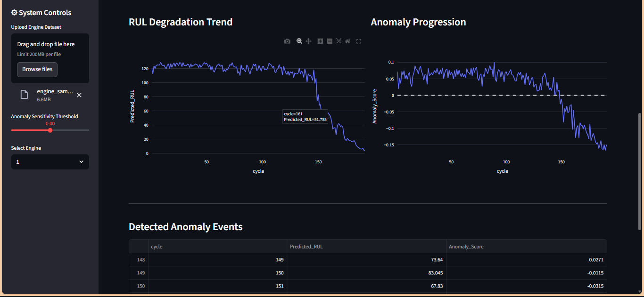
Results
Dept of Computer Engineering

Slide 24
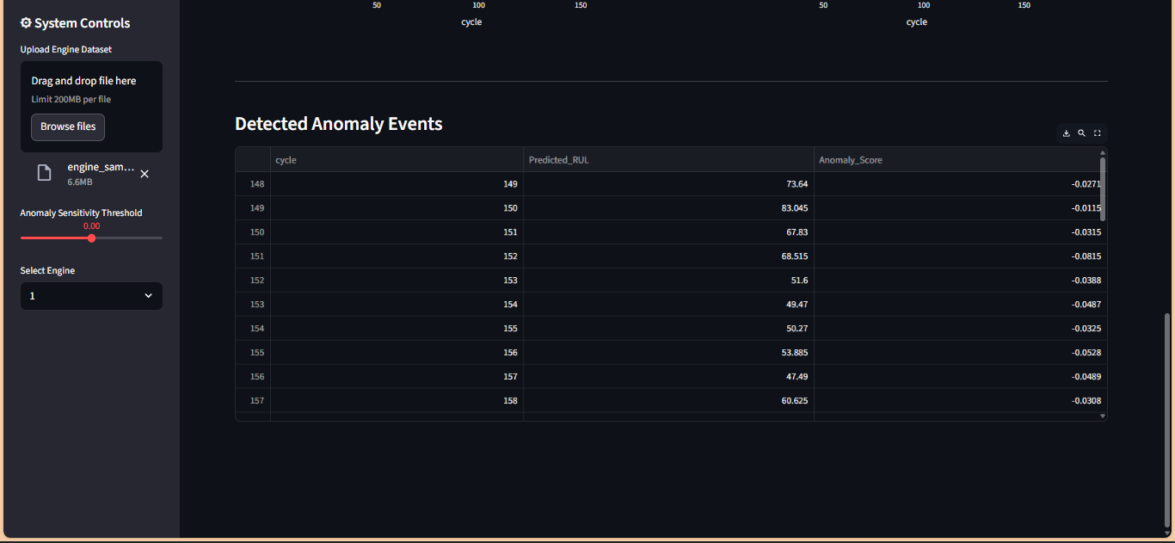
Results
Dept of Computer Engineering

Slide 25
Conclusion
This project successfully developed an end-to-end AI-based predictive maintenance system, achieving strong RUL prediction performance with a Random Forest RMSE of approximately 17.9 and detecting early failure patterns nearly 40 cycles before breakdown. By combining supervised and unsupervised learning models, the system delivers robust and comprehensive equipment monitoring, further demonstrated through a fully interactive real-time dashboard deployment.
This system enables data-driven maintenance decisions instead of reactive repair strategies.
Dept of Computer Engineering

Slide 26
Future Scope
Integration with real-time IoT sensor streams.
Implementation of deep learning models (LSTM / GRU) for sequence modeling.
Integration with ERP / CMMS systems for automated maintenance scheduling.
Cloud-based deployment for scalable industrial monitoring.
Adaptive threshold learning for dynamic anomaly detection.
The framework can evolve into a full-scale industrial asset health management platform.
Dept of Computer Engineering

Slide 27
Research and References
Saxena & K. Goebel, “NASA Turbofan Engine Degradation Simulation Data Set,” NASA Prognostics Data Repository.
S. M. Elsherif, “Deep Learning Prognostic Strategy for Remaining Useful Life”, Scientific Reports, 2025.
A. Motrani et al., Predictive Maintenance: A Machine Learning Approach to RUL, ICIMPE 2024.
K. Ensarioğlu et al., Deep Learning–Based RUL Estimation of Turbofan Engines, MDPI Applied Sciences, 2023.
“Isolation Forest,” Wikipedia.M. L. Ndao, Machine Learning Preprocessing & Explainability Impact, 2025.
B. Taşcı et al., RUL Prediction in Manufacturing Using ML Models, 2025.
NASA CMAPSS Dataset Description.Isolation Forest Survey – IEEE (various authors), 2025.
Dept of Computer Engineering

Slide 28


